Slide 1
Spring Webmvc’s System Architecture
Group4
吳崇維 陳熙 林柏劭 王俊翔 蔡昀達
王郁婷 林慶珠 王廷峻 黃柏諭

Slide 2
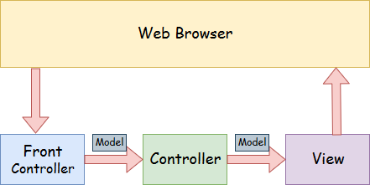

Slide 3
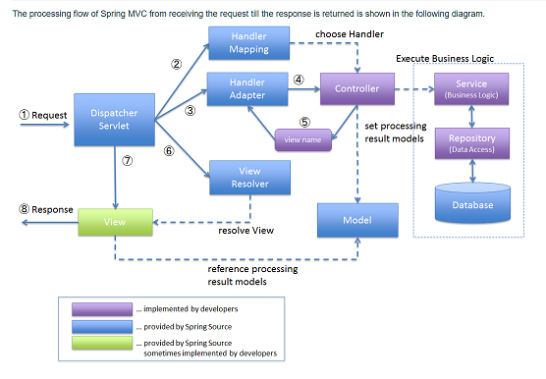

Slide 4
spring mvc
DispatcherServlet
HandlerMapping
HandlerAdapter
ViewResolver
View

Slide 5
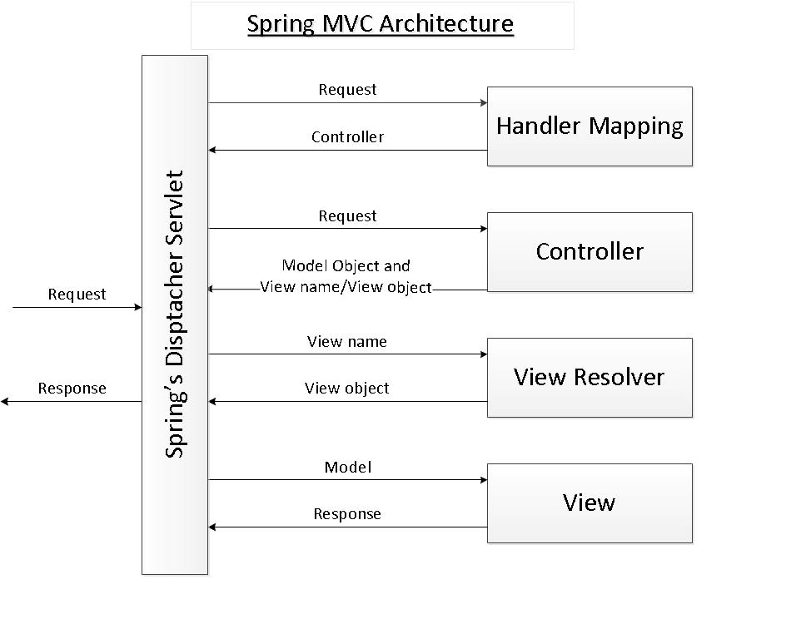
DispatcherServlet
Spring’s front controller. DispatcherServlet handles an incoming HttpRequest, delegates the request, and processes that request according to the configured HandlerAdapter interfaces.

Slide 6
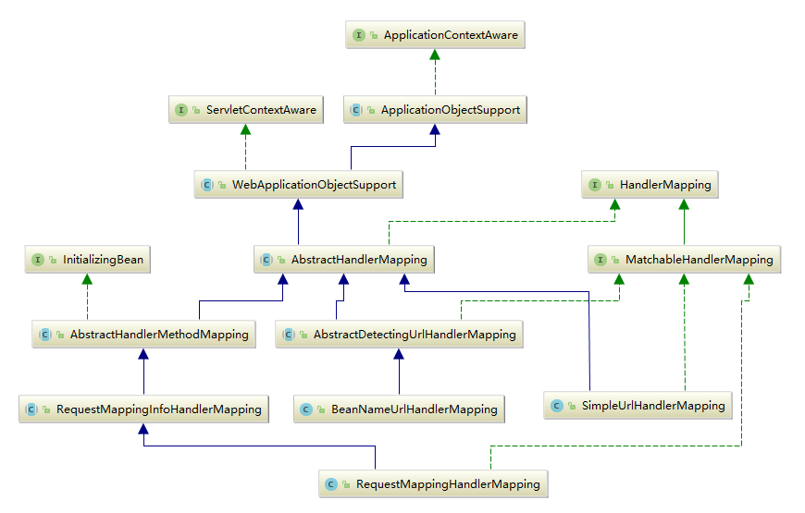
HandlerMapping
Map incoming web requests to appropriate handlers.

Slide 7
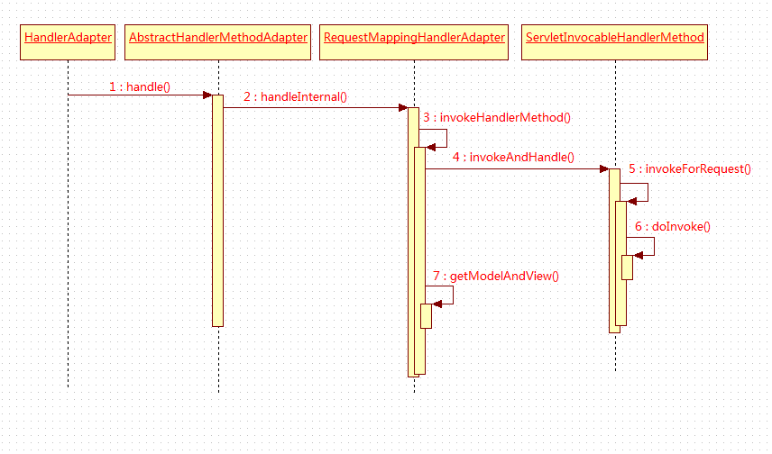
HandlerAdapter
Help the DispatcherServlet to invoke a handler mapped to a request.

Slide 8
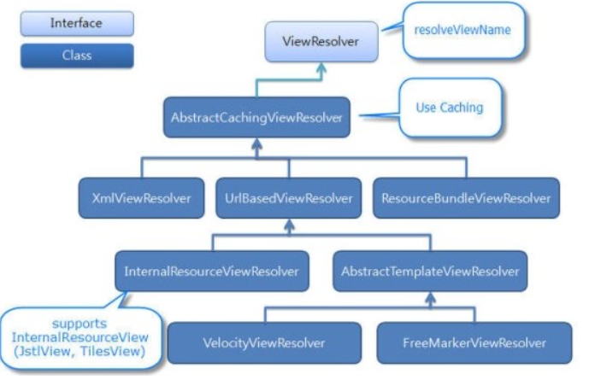
ViewResolver
A ViewResolver determines what kind of views are served by the dispatcher.

Slide 9
View
Set model request and render the content with dispather severlet

